Slide 1
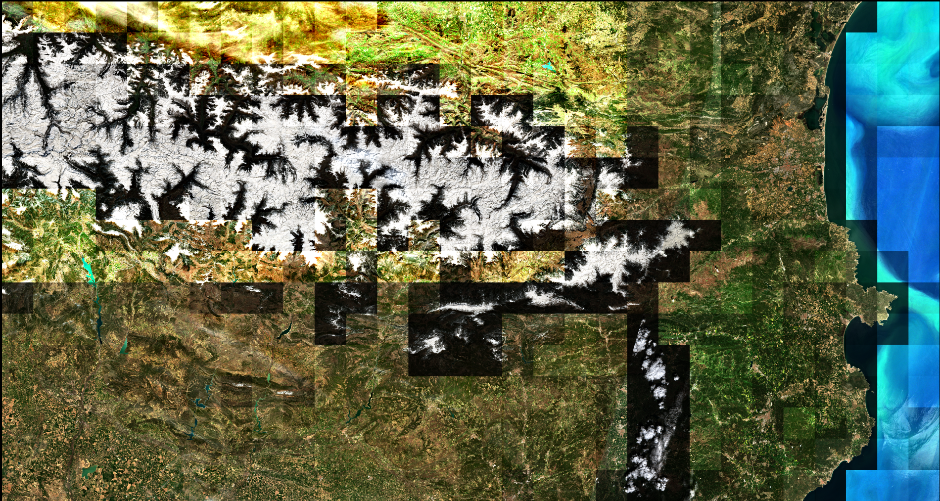
1 | 31 | 61 | 91 | 121 | 151 | 181 | 211 | 241 | 271 | 301 | 331 | 361 | 391 | 421 | 451 | 481 | 511 | 541 | 571 | 601 | 641 | 661 | 691 | 721 | 751 | 781 | 811 | 841 | 871
2 | 32 | 62
3 | 33 | 63
4 | 34 | 64
5 | 35 | 65 |  |  |  |  |  |  |  |  |  |  |  |  |  |  | 515
6 | 36 | 66 |  |  |  |  |  |  |  |  |  |  |  |  |  |  |  | 546
7 | 37 | 67 |  | 127 | 157 | 187 | 217 | 237
8 | 38 |  |  |  |  |  |  |  | 278 |  |  |  |  |  |  |  |  |  |  | 608 | 638
9 | 39
10 | 40
11 | 41
12 | 42
13 | 43
14 | 44
15 | 45
17 |  |  |  |  |  |  |  |  |  |  |  |  |  |  |  |  |  |  |  | 617 | 647

